Slide 1
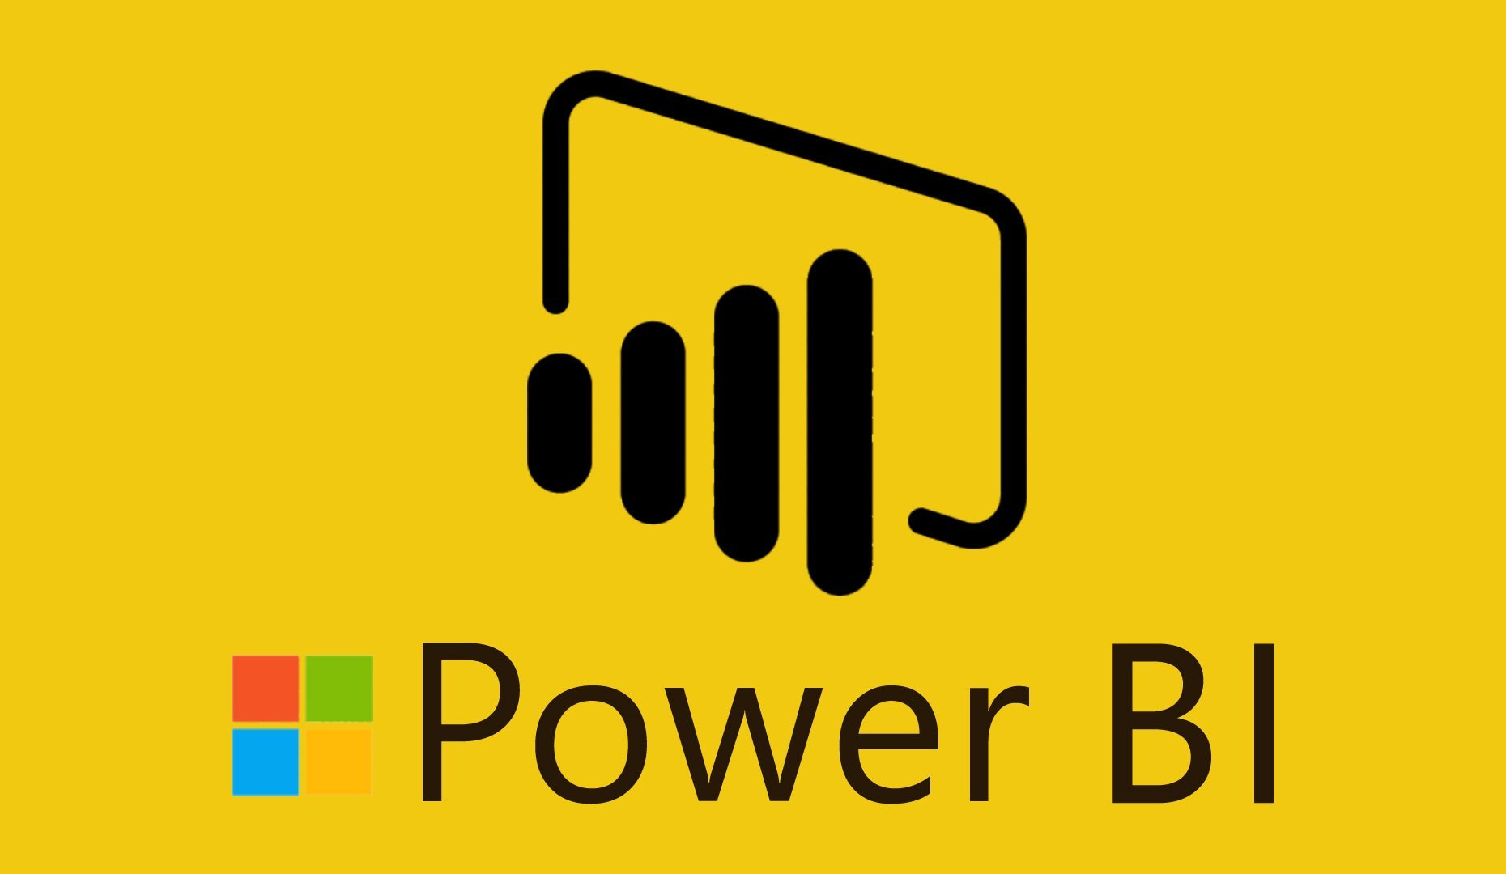

Slide 2
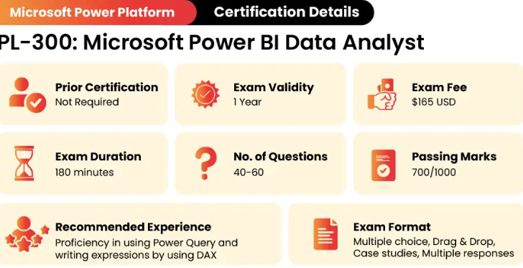
Pl 300 Certification Details
100 minutes

Slide 3
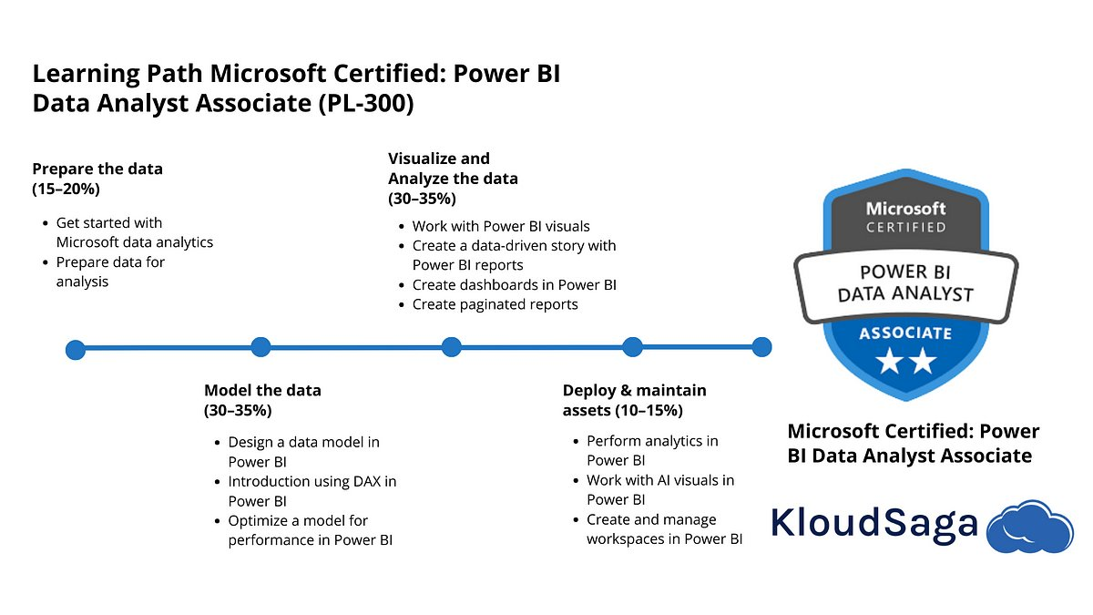
Pl 300 Certification Content
(25-30%)
(25-30%)
Manage and secure Power BI (15-20%)
(25-30%)
Create and manage workspaces and assets
Secure and govern Power BI items

Slide 4

Microsoft Power BI is a complete reporting solution that offers data preparation, data visualization, distribution, and management through development tools and an online platform.
Power BI can scale from simple reports using a single data source to reports requiring complex data modeling and consistent themes. Use Power BI to create visually stunning, interactive reports to serve as the analytics and decision engine behind group projects, divisions, or entire organizations.
Power BI is an essential tool to data analysts and their organization; however, all data professionals benefit from understanding how Power BI works to explore and present data insights within organizations.

Slide 5
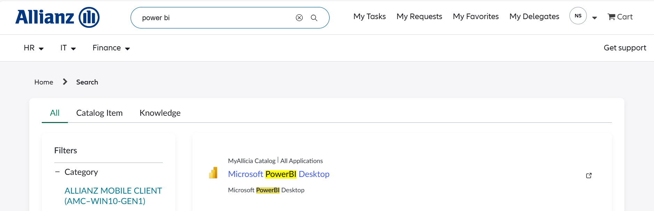
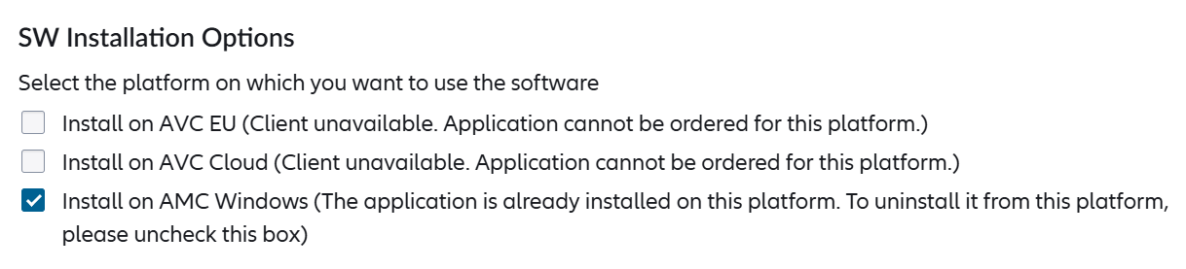
Installing Power BI (Using App Store)
In app store, search for Power BI in search bar. Select on Microsoft Power BI Desktop
Choose the 'Install on AMC Windows' option during installation and submit your order. Once approved, the software will be installed on your system.

Slide 6
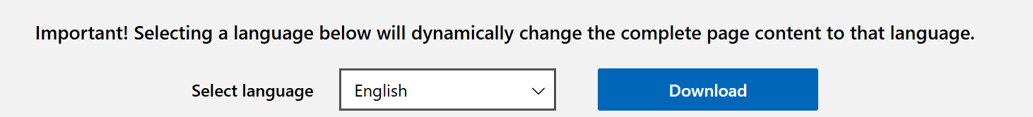
Installing Power BI (From Microsoft’s Website)
Refer below link to download Microsoft Power BI
Download Microsoft Power BI Desktop from Official Microsoft Download Center
Choose your preferred language for the software and download the installation file. Opt for the 64-bit version, 'PBIDesktopSetup_x64.exe,' if your system supports it.
Install Power BI by opening the downloaded file, just like you would with any other application.

Slide 7
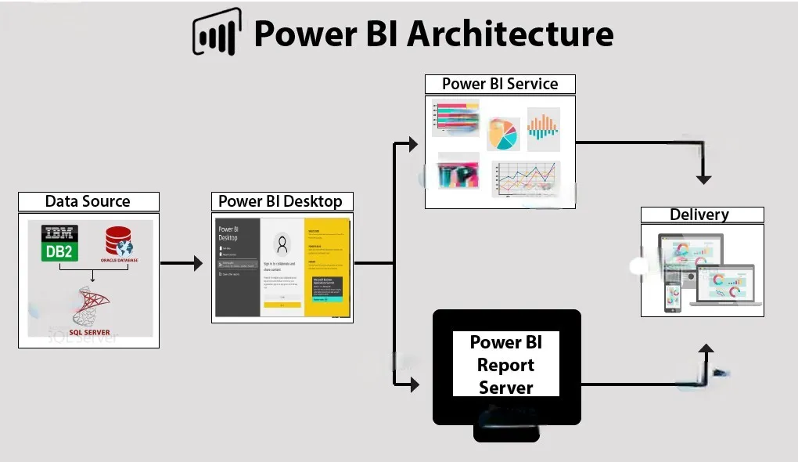
Flow
Connect to data with Power BI Desktop.
Transform and model data with Power BI Desktop.
Create visualizations and reports with Power BI Desktop.
Publish report to Power BI service.
Distribute and manage reports in the Power BI service.

Slide 8
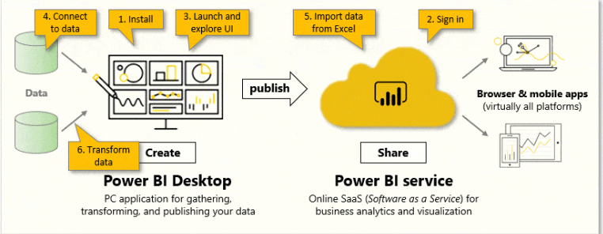
Power BI Service
Workspaces are the foundation of the Power BI service. When publishing any report, you must choose a workspace. By default, every user has access to My workspace, which is ideal only for testing. When you want to share content with others, always create and use a shared workspace.

Slide 9
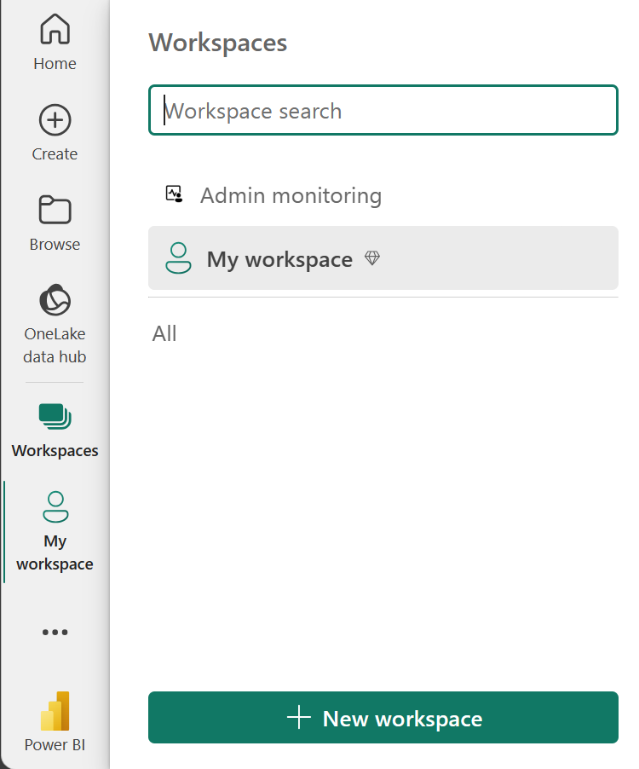
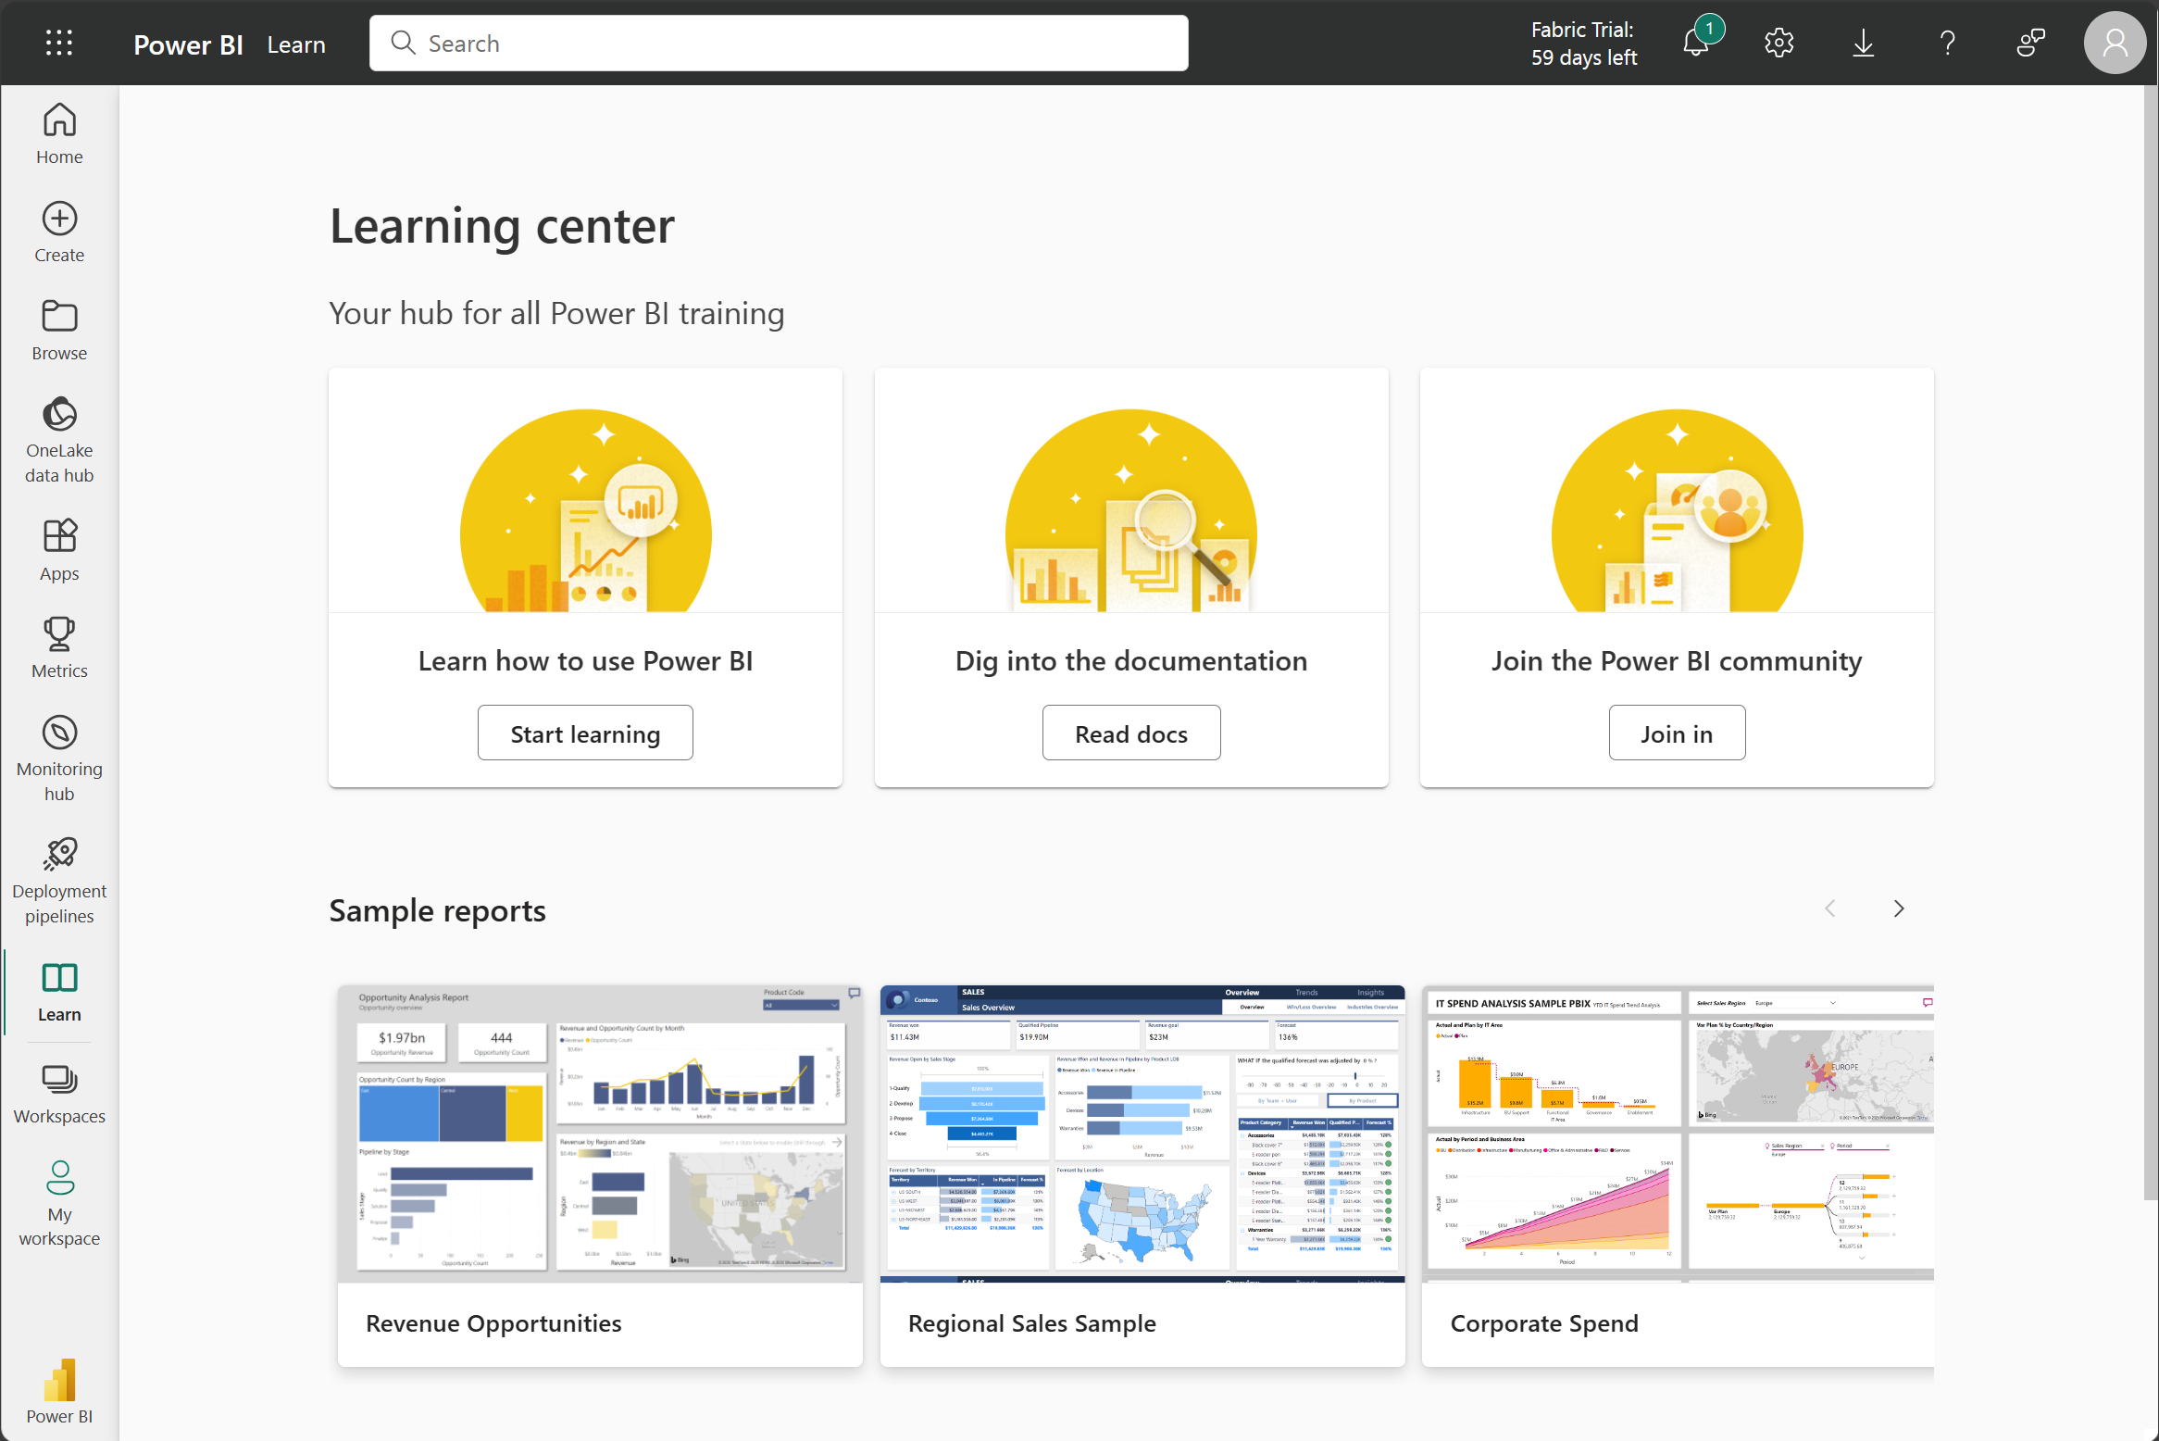
Power BI Service

